Slide 1
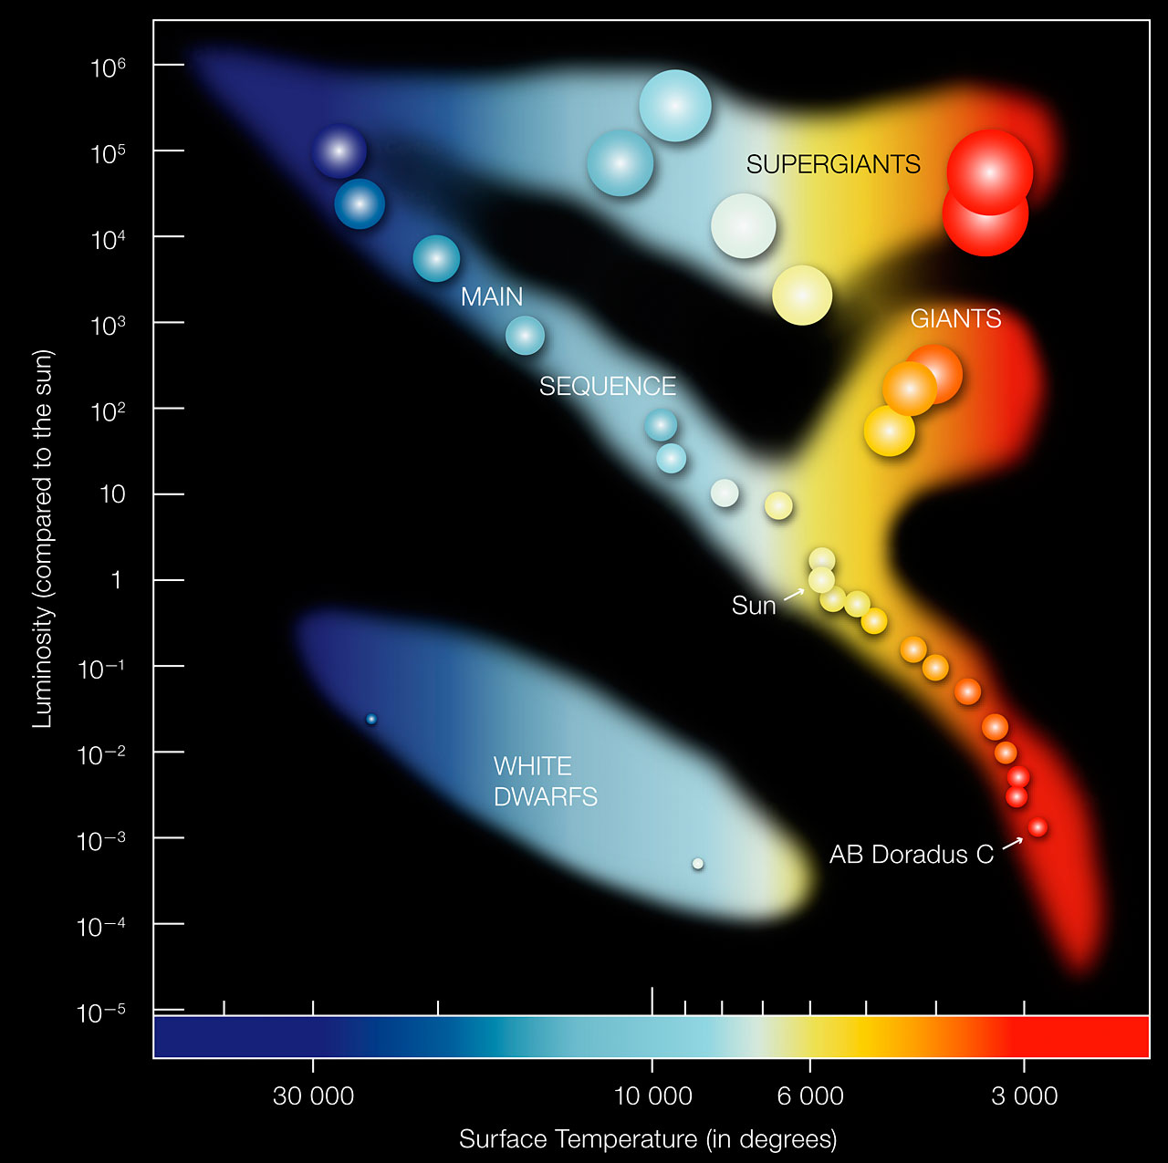
Stellar Evolution
Lim Li Xin Jed
“What is a type IA supernova?” – Astrigue Host
“Star go boom boom boom” – A Y2 (at the time)

Slide 2
1
Protostars
Babies
2
Main Sequence
Normal people
3
Giants
Much larger than me😢
4
Stellar Remnants
GR and QM die
Protostars
Main Sequence
Giants
Stellar Remnants
Notes:
Here are my contents for today. (click)

Slide 3
Protostars
Protostars
Main Sequence
Giants
Stellar Remnants
Notes:
First, let us go through some basics. (click)

Slide 4
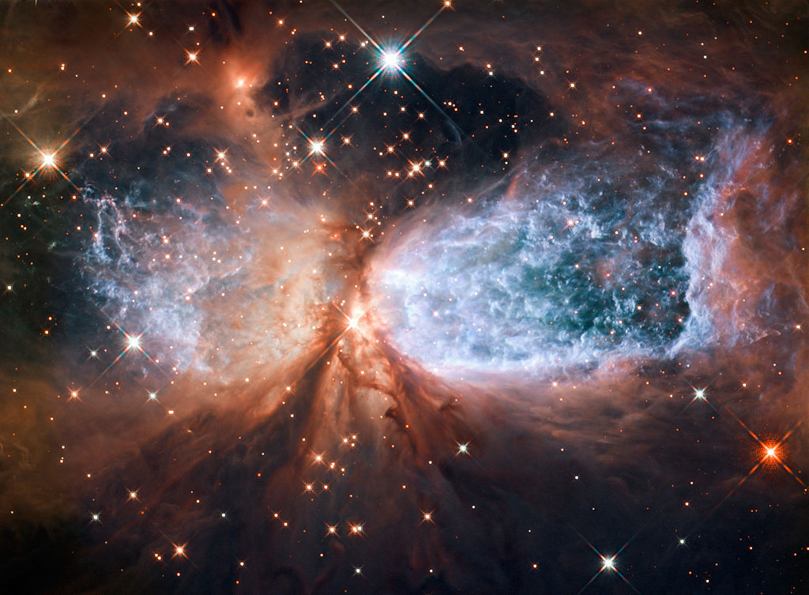
Stellar Formation
In a stellar nursery far far away…
Protostars
Main Sequence
Giants
Stellar Remnants
Notes:
This is my experimental setup. (click) A signal generator is used to generate a signal that passed to (click) the speaker which plays the sound. (click) The disk is placed in front of the speaker and (click A decibel meter is used to accurately measure the intensity of the sound which is stored by (click) the datalogger. (click) The motion of the disk is recorded by a camera. (click)

Slide 5
Stellar Formation
In a stellar nursery far far away…
Gravity attracts the dust together
Protostars
Main Sequence
Giants
Stellar Remnants
Notes:
This is my experimental setup. (click) A signal generator is used to generate a signal that passed to (click) the speaker which plays the sound. (click) The disk is placed in front of the speaker and (click A decibel meter is used to accurately measure the intensity of the sound which is stored by (click) the datalogger. (click) The motion of the disk is recorded by a camera. (click)

Slide 6
Stellar Formation
In a stellar nursery far far away…
Protostars
Main Sequence
Giants
Stellar Remnants
Notes:
This is my experimental setup. (click) A signal generator is used to generate a signal that passed to (click) the speaker which plays the sound. (click) The disk is placed in front of the speaker and (click A decibel meter is used to accurately measure the intensity of the sound which is stored by (click) the datalogger. (click) The motion of the disk is recorded by a camera. (click)

Slide 7
Stellar Formation
In a stellar nursery far far away…
Protostar begins emitting light and its gravity attracts a circumstellar disk
Protostars
Main Sequence
Giants
Stellar Remnants
Notes:
This is my experimental setup. (click) A signal generator is used to generate a signal that passed to (click) the speaker which plays the sound. (click) The disk is placed in front of the speaker and (click A decibel meter is used to accurately measure the intensity of the sound which is stored by (click) the datalogger. (click) The motion of the disk is recorded by a camera. (click)

Slide 8
Stellar Formation
In a stellar nursery far far away…
Protostar becomes a star when nuclear fusion begins
Protostars
Main Sequence
Giants
Stellar Remnants
Notes:
This is my experimental setup. (click) A signal generator is used to generate a signal that passed to (click) the speaker which plays the sound. (click) The disk is placed in front of the speaker and (click A decibel meter is used to accurately measure the intensity of the sound which is stored by (click) the datalogger. (click) The motion of the disk is recorded by a camera. (click)

Slide 9
Brown Dwarf
In a stellar nursery far far away…
Protostar becomes a brown dwarf when it stops growing in size but hydrogen fusion has not started
However, it may fuse deuterium.
Protostars
Main Sequence
Giants
Stellar Remnants
Notes:
This is my experimental setup. (click) A signal generator is used to generate a signal that passed to (click) the speaker which plays the sound. (click) The disk is placed in front of the speaker and (click A decibel meter is used to accurately measure the intensity of the sound which is stored by (click) the datalogger. (click) The motion of the disk is recorded by a camera. (click)

Slide 10
Main Sequence
Protostars
Main Sequence
Giants
Stellar Remnants
Notes:
Let’s take a look at why. (click)

Slide 11
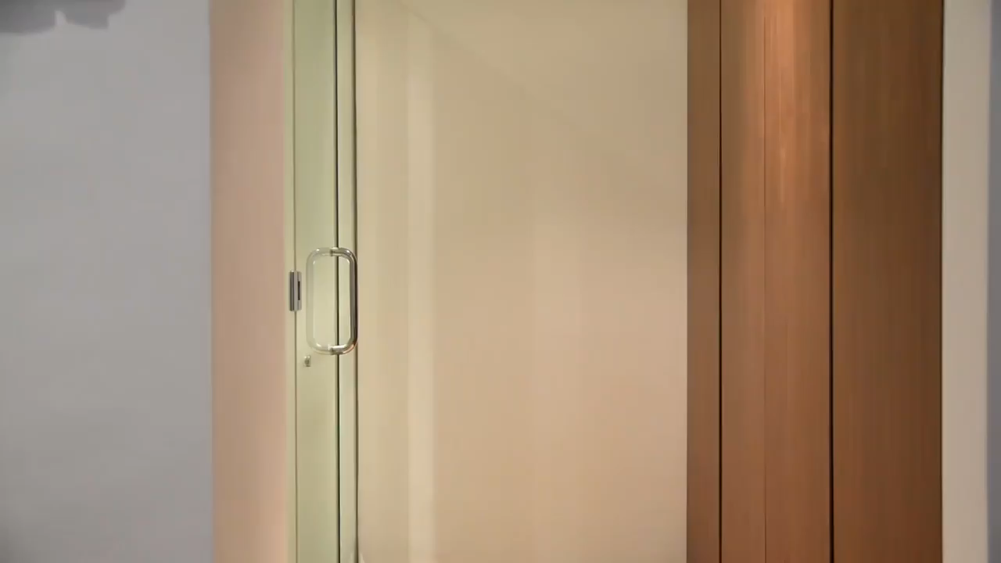
ArE AlL StArS lIkE oUr SuN??
Protostars
Main Sequence
Giants
Stellar Remnants
Notes:
To understand the origin of the torque on the disk, we will consider the sound wave hitting the disk. We can plot the pressure at (click) point A and (click) point B. We note that the pressures are out of phase. In the first region, (click) we note that the torque acting on the disk is clockwise while in the (click) 2nd region, the torque acting on the disk is anti-clockwise. (click) Taking the time-average torque, we note that it is zero as the sound wave is sinusoidal. Thus, the initial sound wave cannot account for the torque of the disk. (click)

Slide 12
Hertzsprung Russell Diagram
Protostars
Main Sequence
Giants
Stellar Remnants
Notes:
To understand the origin of the torque on the disk, we will consider the sound wave hitting the disk. We can plot the pressure at (click) point A and (click) point B. We note that the pressures are out of phase. In the first region, (click) we note that the torque acting on the disk is clockwise while in the (click) 2nd region, the torque acting on the disk is anti-clockwise. (click) Taking the time-average torque, we note that it is zero as the sound wave is sinusoidal. Thus, the initial sound wave cannot account for the torque of the disk. (click)

Slide 13
Star Classification
Oh Boy An F Grade Kills Me
Hottest
Coolest
🥵
😎
Protostars
Main Sequence
Giants
Stellar Remnants
Notes:
To understand the origin of the torque on the disk, we will consider the sound wave hitting the disk. We can plot the pressure at (click) point A and (click) point B. We note that the pressures are out of phase. In the first region, (click) we note that the torque acting on the disk is clockwise while in the (click) 2nd region, the torque acting on the disk is anti-clockwise. (click) Taking the time-average torque, we note that it is zero as the sound wave is sinusoidal. Thus, the initial sound wave cannot account for the torque of the disk. (click)

Slide 14
Structure of a Star
Core: Where fusion occurs
Convective Zone:
Convection occurs as hot plasma from the inner layers rises while cooler plasma falls
Radiative Zone:
A layer of a star's interior where energy is primarily transported toward the exterior by means of radiative diffusion and thermal conduction, rather than by convection.
Protostars
Main Sequence
Giants
Stellar Remnants
Notes:
To understand the origin of the torque on the disk, we will consider the sound wave hitting the disk. We can plot the pressure at (click) point A and (click) point B. We note that the pressures are out of phase. In the first region, (click) we note that the torque acting on the disk is clockwise while in the (click) 2nd region, the torque acting on the disk is anti-clockwise. (click) Taking the time-average torque, we note that it is zero as the sound wave is sinusoidal. Thus, the initial sound wave cannot account for the torque of the disk. (click)

Slide 15

Structure of a Star
< 0.5 M☉
0.5 – 1.5 M☉
> 1.5 M☉
Arrangement of layers in different mass stars is different
Protostars
Main Sequence
Giants
Stellar Remnants
Notes:
To understand the origin of the torque on the disk, we will consider the sound wave hitting the disk. We can plot the pressure at (click) point A and (click) point B. We note that the pressures are out of phase. In the first region, (click) we note that the torque acting on the disk is clockwise while in the (click) 2nd region, the torque acting on the disk is anti-clockwise. (click) Taking the time-average torque, we note that it is zero as the sound wave is sinusoidal. Thus, the initial sound wave cannot account for the torque of the disk. (click)

Slide 16
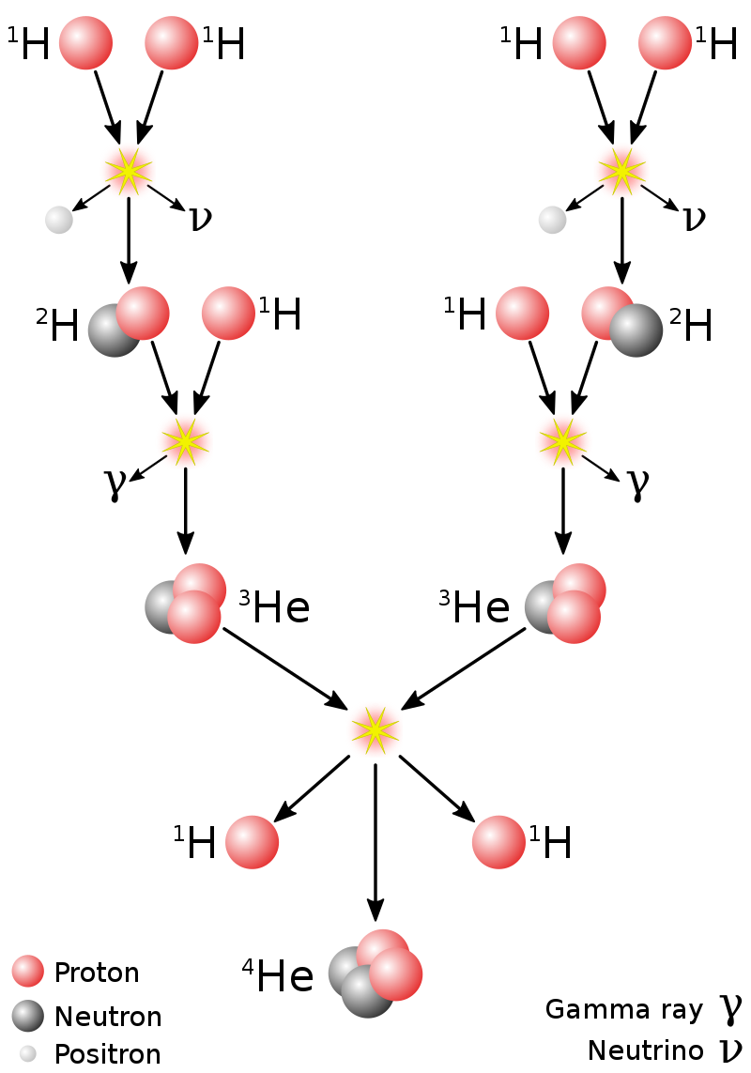
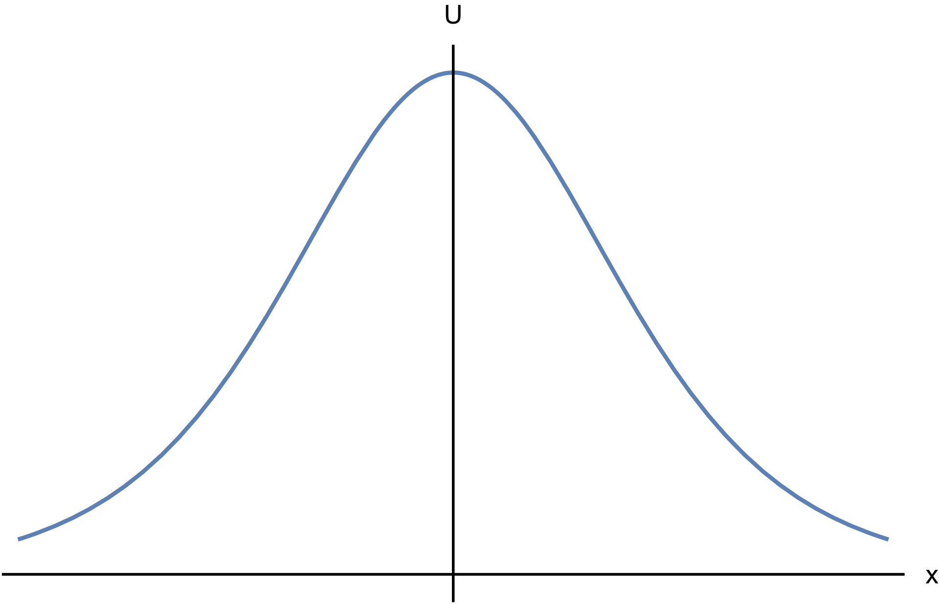
Proton-Proton Chain
The sun has insufficient energy for the protons to overcome the Coulomb Barrier.
Protons are fused through quantum tunnelling.
Protostars
Main Sequence
Giants
Stellar Remnants

Slide 17
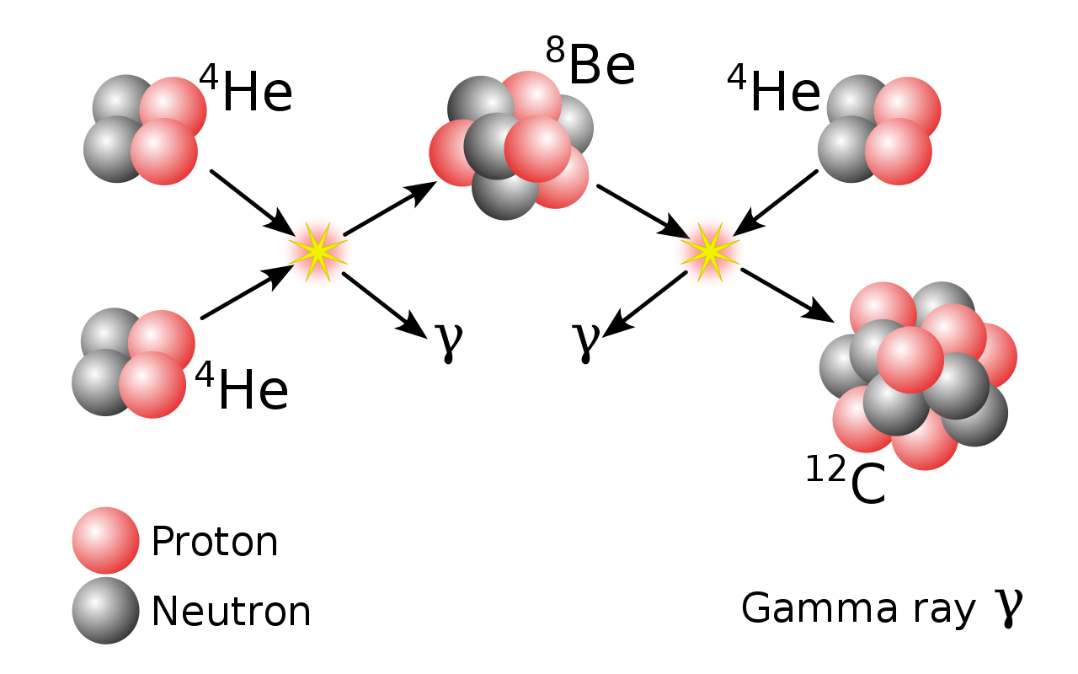
Triple Alpha Process
Converts helium into carbon
Protostars
Main Sequence
Giants
Stellar Remnants
Notes:
To understand the origin of the torque on the disk, we will consider the sound wave hitting the disk. We can plot the pressure at (click) point A and (click) point B. We note that the pressures are out of phase. In the first region, (click) we note that the torque acting on the disk is clockwise while in the (click) 2nd region, the torque acting on the disk is anti-clockwise. (click) Taking the time-average torque, we note that it is zero as the sound wave is sinusoidal. Thus, the initial sound wave cannot account for the torque of the disk. (click)

Slide 18
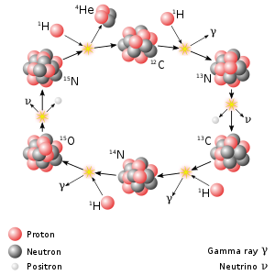
Carbon-Nitrogen-Oxygen Cycle
Converts hydrogen to helium.
The carbon, oxygen and nitrogen are catalysts
Occurs primarily in higher mass stars
Protostars
Main Sequence
Giants
Stellar Remnants
Notes:
To understand the origin of the torque on the disk, we will consider the sound wave hitting the disk. We can plot the pressure at (click) point A and (click) point B. We note that the pressures are out of phase. In the first region, (click) we note that the torque acting on the disk is clockwise while in the (click) 2nd region, the torque acting on the disk is anti-clockwise. (click) Taking the time-average torque, we note that it is zero as the sound wave is sinusoidal. Thus, the initial sound wave cannot account for the torque of the disk. (click)

Slide 19
Giants
Protostars
Main Sequence
Giants
Stellar Remnants
Notes:
Now, we will attempt to quantitatively model this phenomenon. (click)

Slide 20
Transition to Red Giants
Stellar Envelope
Core (Fusing H₂)
Eventually, the core runs out of hydrogen
Protostars
Main Sequence
Giants
Stellar Remnants
Notes:
To understand the origin of the torque on the disk, we will consider the sound wave hitting the disk. We can plot the pressure at (click) point A and (click) point B. We note that the pressures are out of phase. In the first region, (click) we note that the torque acting on the disk is clockwise while in the (click) 2nd region, the torque acting on the disk is anti-clockwise. (click) Taking the time-average torque, we note that it is zero as the sound wave is sinusoidal. Thus, the initial sound wave cannot account for the torque of the disk. (click)

Slide 21
Transition to Red Giants
Stellar Envelope
He Core
H₂ Shell
Gravity pulls the star’s outer layers inwards
Star heats up and the hydrogen around the core starts fusing
Protostars
Main Sequence
Giants
Stellar Remnants
Notes:
To understand the origin of the torque on the disk, we will consider the sound wave hitting the disk. We can plot the pressure at (click) point A and (click) point B. We note that the pressures are out of phase. In the first region, (click) we note that the torque acting on the disk is clockwise while in the (click) 2nd region, the torque acting on the disk is anti-clockwise. (click) Taking the time-average torque, we note that it is zero as the sound wave is sinusoidal. Thus, the initial sound wave cannot account for the torque of the disk. (click)

Slide 22
Transition to Red Giants
Heat from fusion pushes the stellar envelope outwards
Protostars
Main Sequence
Giants
Stellar Remnants
Notes:
To understand the origin of the torque on the disk, we will consider the sound wave hitting the disk. We can plot the pressure at (click) point A and (click) point B. We note that the pressures are out of phase. In the first region, (click) we note that the torque acting on the disk is clockwise while in the (click) 2nd region, the torque acting on the disk is anti-clockwise. (click) Taking the time-average torque, we note that it is zero as the sound wave is sinusoidal. Thus, the initial sound wave cannot account for the torque of the disk. (click)

Slide 23
Red Giants
Protostars
Main Sequence
Giants
Stellar Remnants

Slide 24
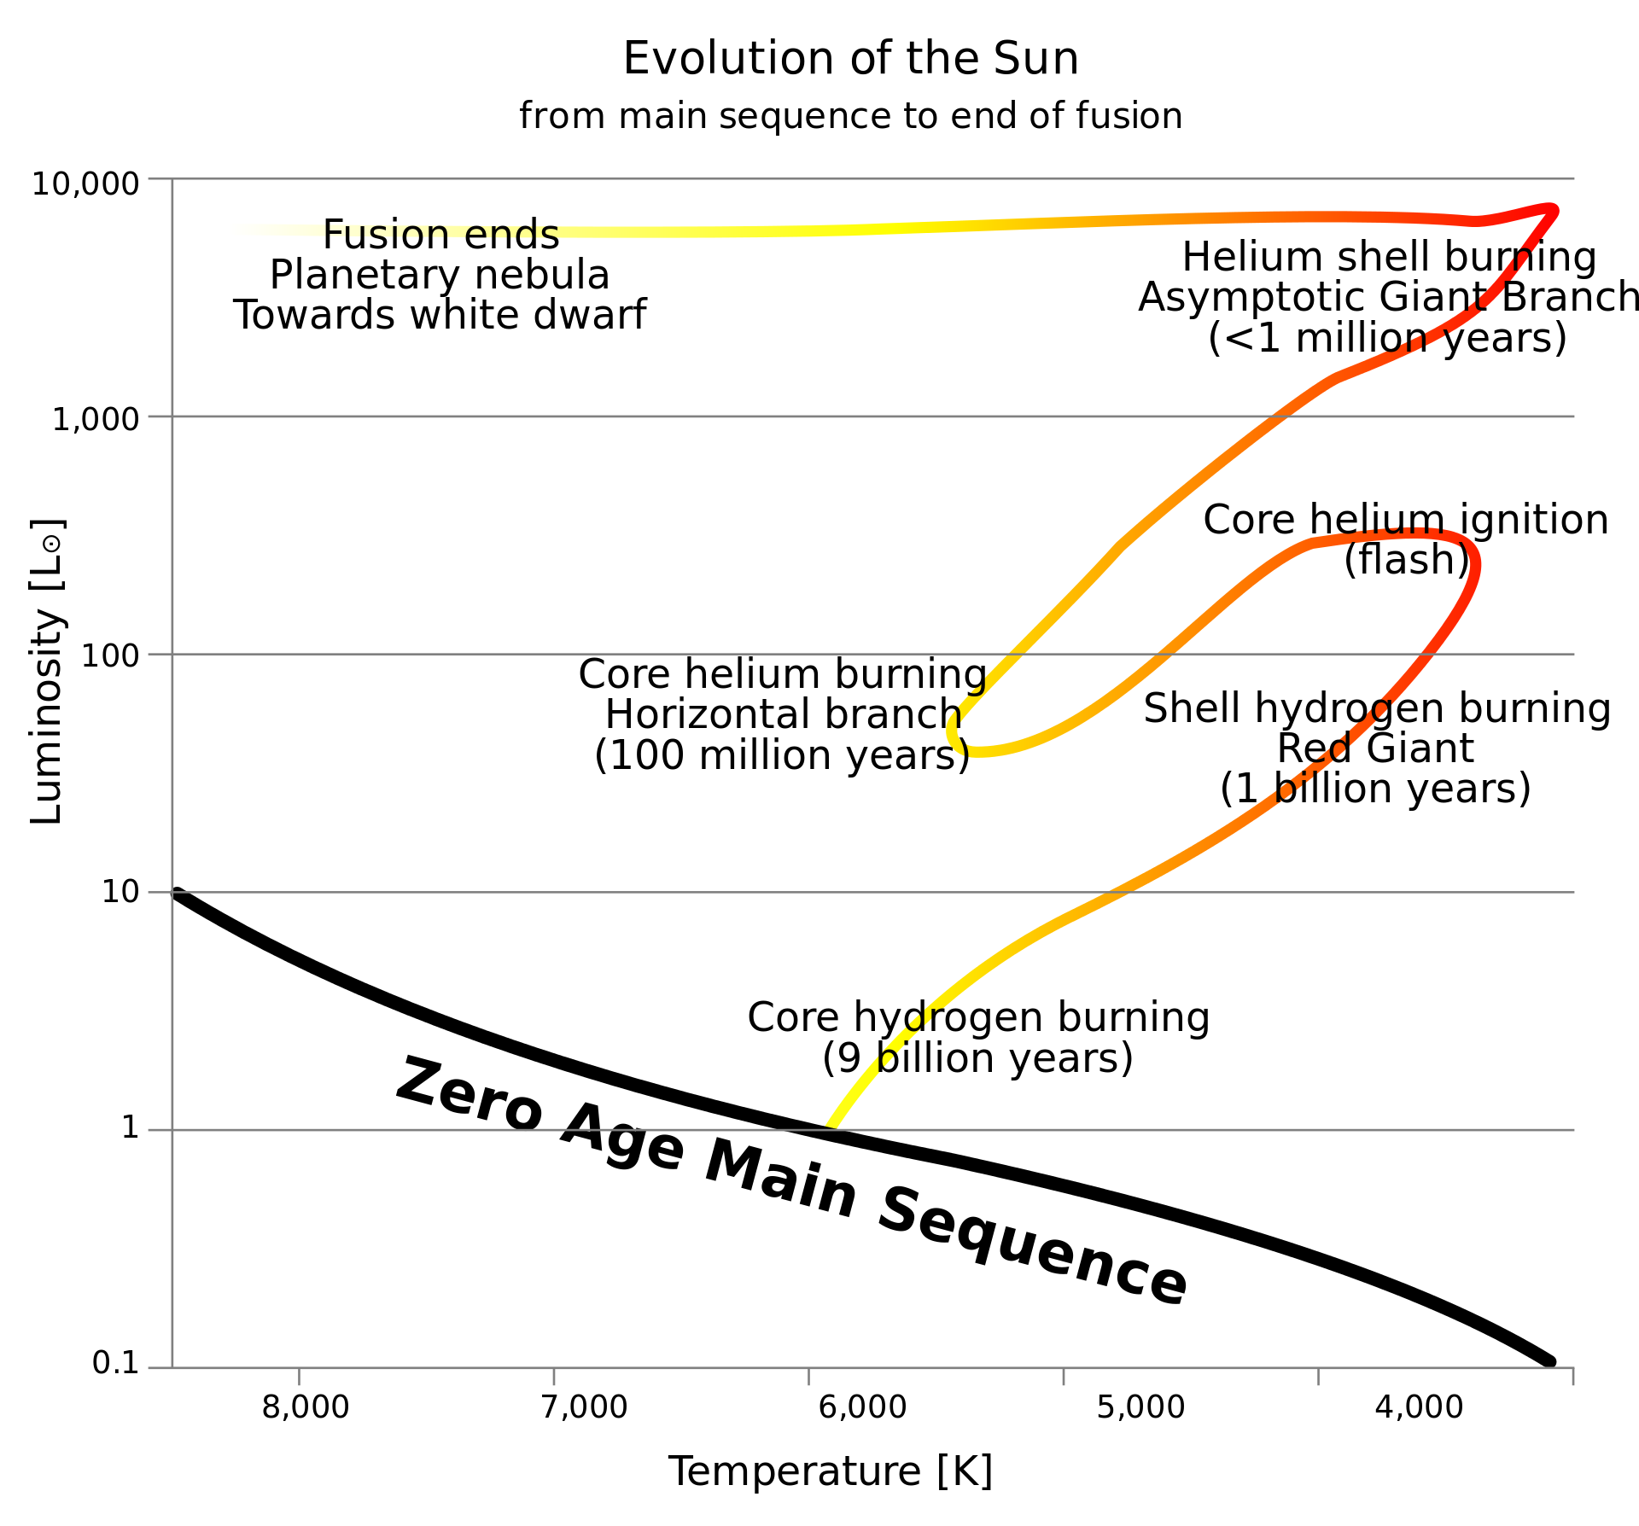
HR Diagram – Low Mass Stars
The star undergoes a helium flash (helium is fused into carbon and oxygen in a few seconds)
The shell of Helium around the core that is fusing is unstable and will eject the star’s outer layers.
Protostars
Main Sequence
Giants
Stellar Remnants

Slide 25
Stellar Remnants
Protostars
Main Sequence
Giants
Stellar Remnants

Slide 26
Death of a Low-Mass Star Stars below 8 Solar Masses
Eventually, the red giant runs out of fuel.
Burning of Helium around the core ejects the outer layers of the star.
Red Giant
Protostars
Main Sequence
Giants
Stellar Remnants

Slide 27
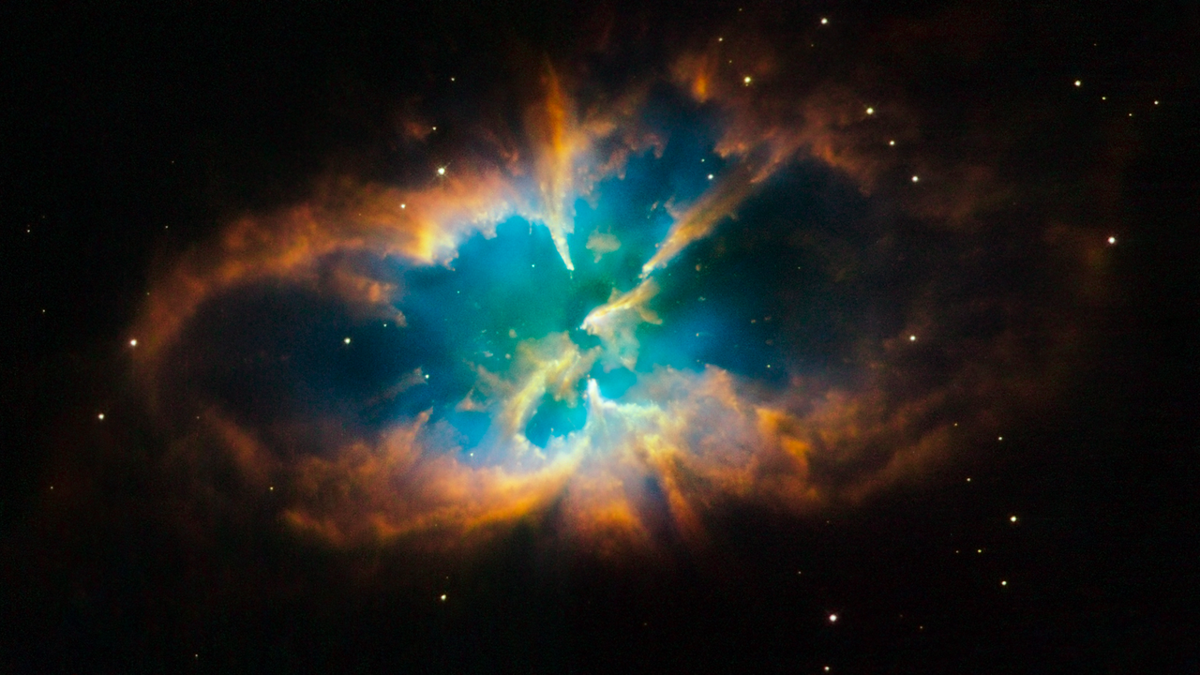
Planetary Nebula
Protostars
Main Sequence
Giants
Stellar Remnants

Slide 28
White Dwarf
Approximately as large as Earth but with at least ½ the mass of the sun
Held up against gravity by electron degeneracy pressure
Protostars
Main Sequence
Giants
Stellar Remnants

Slide 29

Black Dwarf
Protostars
Main Sequence
Giants
Stellar Remnants

Slide 30
Death of a High-Mass Star Stars above 8 Solar Masses
Eventually, the red supergiant runs out of fuel.
Lighter elements are converted to heavier elements in the core of the star until iron is produced.
Red Supergiant
Protostars
Main Sequence
Giants
Stellar Remnants

Slide 31
Supernova
Without the outward pressure from fusion, gravity compresses the star.
Red Supergiant
Iron Core
Protostars
Main Sequence
Giants
Stellar Remnants

Slide 32
Supernova
Without the outward pressure from fusion, gravity compresses the star.
The outer layers of the star move inwards and bounce off the iron core.
Red Supergiant
Iron Core
Protostars
Main Sequence
Giants
Stellar Remnants

Slide 33
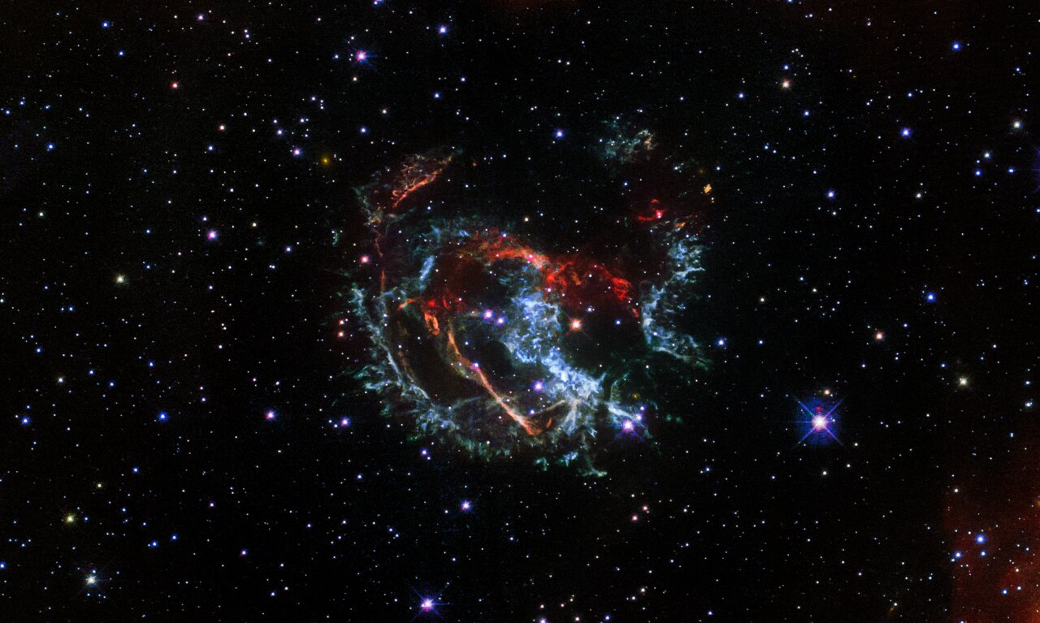
Supernova Renmant
Neutron Star
Protostars
Main Sequence
Giants
Stellar Remnants

Slide 34

Neutron Degeneracy
-
-
Neutron Star
-
Protostars
Main Sequence
Giants
Stellar Remnants

Slide 35
Neutron Degeneracy
-
-
-
Neutron Star
Electrons merge with protons and become neutrons
Protostars
Main Sequence
Giants
Stellar Remnants

Slide 36
Neutron Degeneracy
-
-
-
Neutron Star
Neutron degeneracy counteracts gravity compressing the newly formed neutron star
Protostars
Main Sequence
Giants
Stellar Remnants

Slide 37
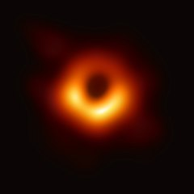
Black Holes
If gravity overcomes neutron degeneracy pressure, a black hole is formed.
Their gravity is so strong (past the event horizon) that even light cannot escape.
At the centre, is a singularity (a point of infinite density)
Protostars
Main Sequence
Giants
Stellar Remnants

